Slide 1
Weekly Project Update
Abdellah Sabhi
Laurent Bialylew

Slide 2
Work done this week
01
02
03
Updated UMLs
Added search function
Updated use case diagram
Added search function to search for books based on title
Added sort function
Added sort function based on book price or title both ascending and descending

Slide 3
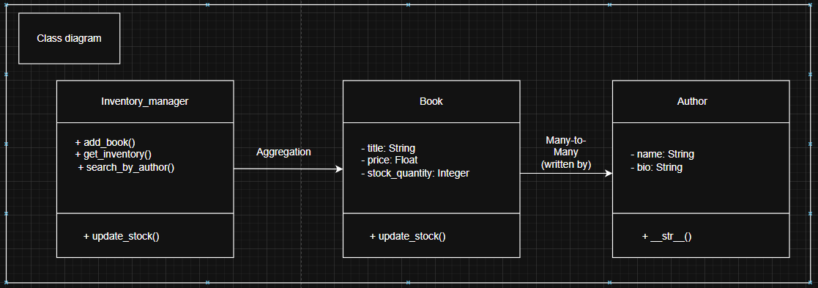
Class UML

Slide 4
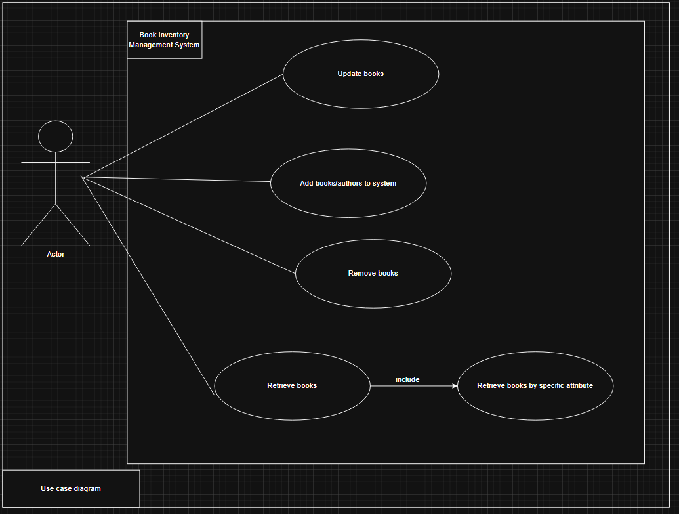
Use case UML

Slide 5
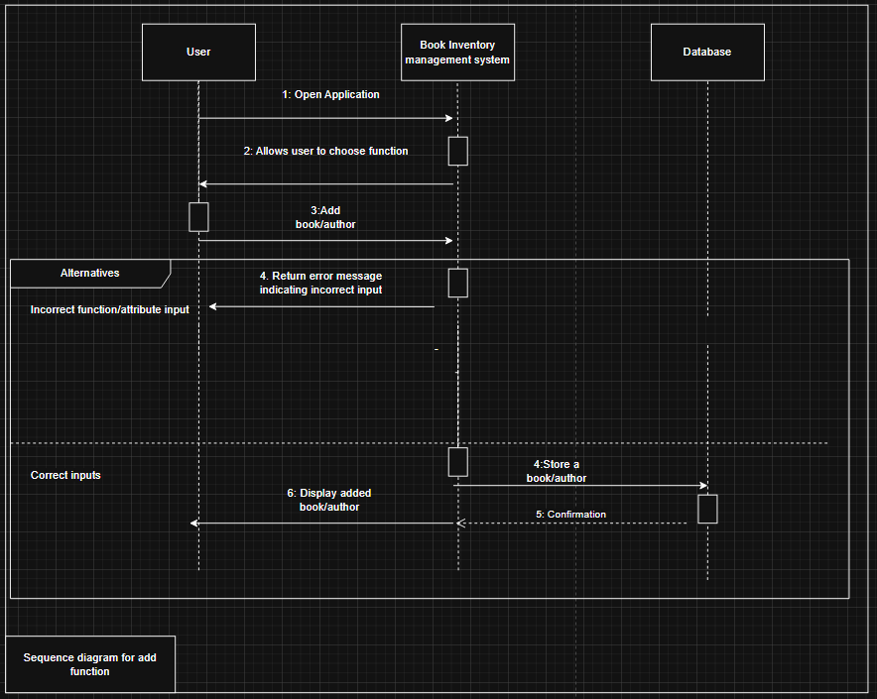
Sequence UML for add function

Slide 6
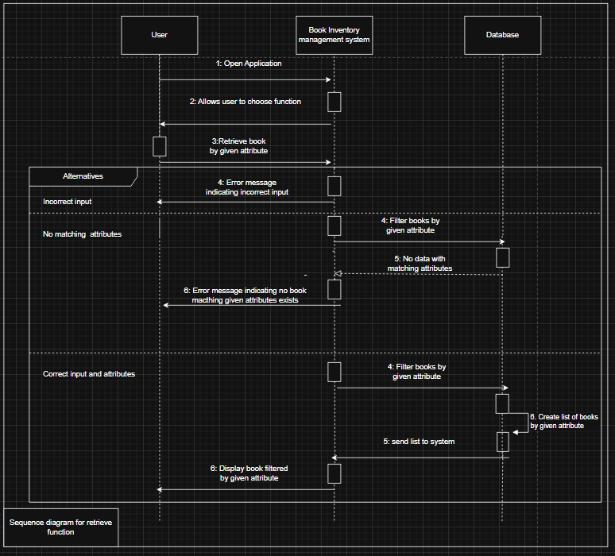
Sequence UML for retrieve function

Slide 7
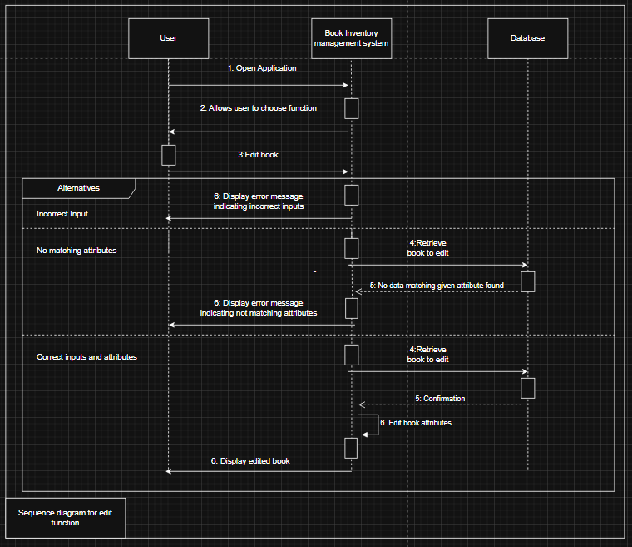
Sequence UML for update function

Slide 8
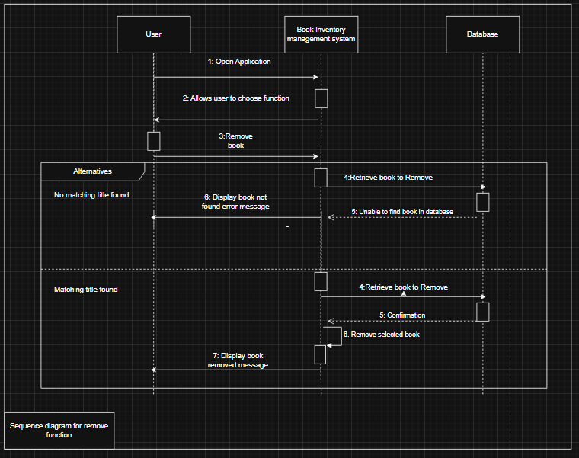
Sequence UML for remove function

